Slide 1
QMST 5335
Exponential Smoothing Methods

Slide 2
Learning Objectives:
Details of Exponential Smoothing Methods
  Simple Exponential Smoothing method
    How does it work? Key points! Implementation and optimization
  Methods with trend
    How does it work? Key points! Implementation and optimization
  Methods with seasonality
    How does it work? Implementation and optimization
  Overview of ETS methods
    Taxonomy

Slide 3
Outline
Exponential Smoothing Methods
  Introduction and Notation
Simple Exponential Smoothing
  Forms and Equations, and Example
  Insights and Optimization
Holt’s Linear Trend Method
  Equations and Example
  Insights, Optimization, and Damping
Holt-Winters’ Seasonal Method
  Equations and Example
  Multiplicative and Damped method
Taxonomy of ETS Methods

Slide 4
Outline
Exponential Smoothing Methods
  Introduction and Notation
Simple Exponential Smoothing
  Forms and Equations, and Example
  Insights and Optimization
Holt’s Linear Trend Method
  Equations and Example
  Insights, Optimization, and Damping
Holt-Winters’ Seasonal Method
  Equations and Example
  Multiplicative and Damped method
Taxonomy of ETS Methods

Slide 5
Exponential Smoothing Methods
Exponential Smoothing (ETS) methods are proposed in late 1950s
  Brown (1959), Holt (1957), Winters (1960)
Main characteristic of ETS methods:
  Forecasts are weighted averages of the past observations
  Weights are decaying exponentially as the observations get older
  More recent observations have higher weights
Most important ETS methods:
  Simple (single) exponential smoothing
  Holt’s Method (Double exponential smoothing)
  Holt-Winters’ Method (Triple exponential smoothing)
    These methods can be used in an additive, multiplicative, or damped manner
  There are also other, more recent, ETS methods

Slide 6
Exponential Smoothing Methods
How to select the right method?
  Depends on the components of the time series
    Is there trend? Is there seasonality? Both? None?
  And how the components are used in the method
    Additive vs. multiplicative vs. damped vs. mixed
ETS methods use a smoothing equation for each existing component of the time series
  A parameter (input to the method) is used for each smoothing equation
  Simple exponential smoothing
    Uses one smoothing equation
    Works with a single parameter

Slide 7
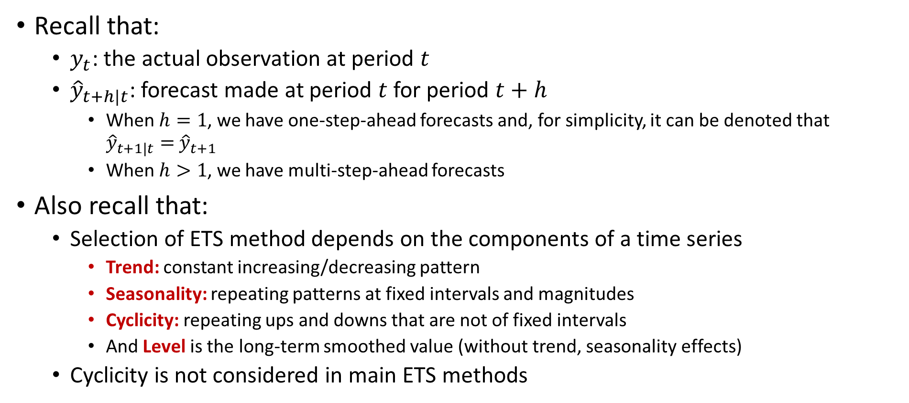
Notation for ETS Methods
Recall that:
  $y_{t}$: the actual observation at period $t$
  ${\hat{y}}_{t+h|t}$: forecast made at period $t$ for period $t+h$
    When $h=1$, we have one-step-ahead forecasts and, for simplicity, it can be denoted that ${\hat{y}}_{t+1|t}=$ ${\hat{y}}_{t+1}$
    When $h>1$, we have multi-step-ahead forecasts
Also recall that:
  Selection of ETS method depends on the components of a time series
    Trend: constant increasing/decreasing pattern
    Seasonality: repeating patterns at fixed intervals and magnitudes
    Cyclicity: repeating ups and downs that are not of fixed intervals
    And Level is the long-term smoothed value (without trend, seasonality effects)
  Cyclicity is not considered in main ETS methods

Slide 8
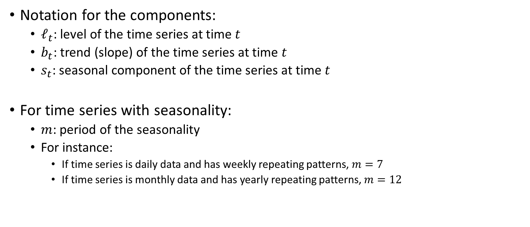
Notation for ETS Methods
Notation for the components:
  $ℓ_{t}$: level of the time series at time $t$
  $b_{t}$: trend (slope) of the time series at time $t$
  $s_{t}$: seasonal component of the time series at time $t$
For time series with seasonality:
  $m$: period of the seasonality
  For instance:
    If time series is daily data and has weekly repeating patterns, $m=7$
    If time series is monthly data and has yearly repeating patterns, $m=12$
Estimated values, and updated as new data becomes available

Slide 9
Outline
Exponential Smoothing Methods
  Introduction and Notation
Simple Exponential Smoothing
  Forms and Equations, and Example
  Insights and Optimization
Holt’s Linear Trend Method
  Equations and Example
  Insights, Optimization, and Damping
Holt-Winters’ Seasonal Method
  Equations and Example
  Multiplicative and Damped method
Taxonomy of ETS Methods

Slide 10
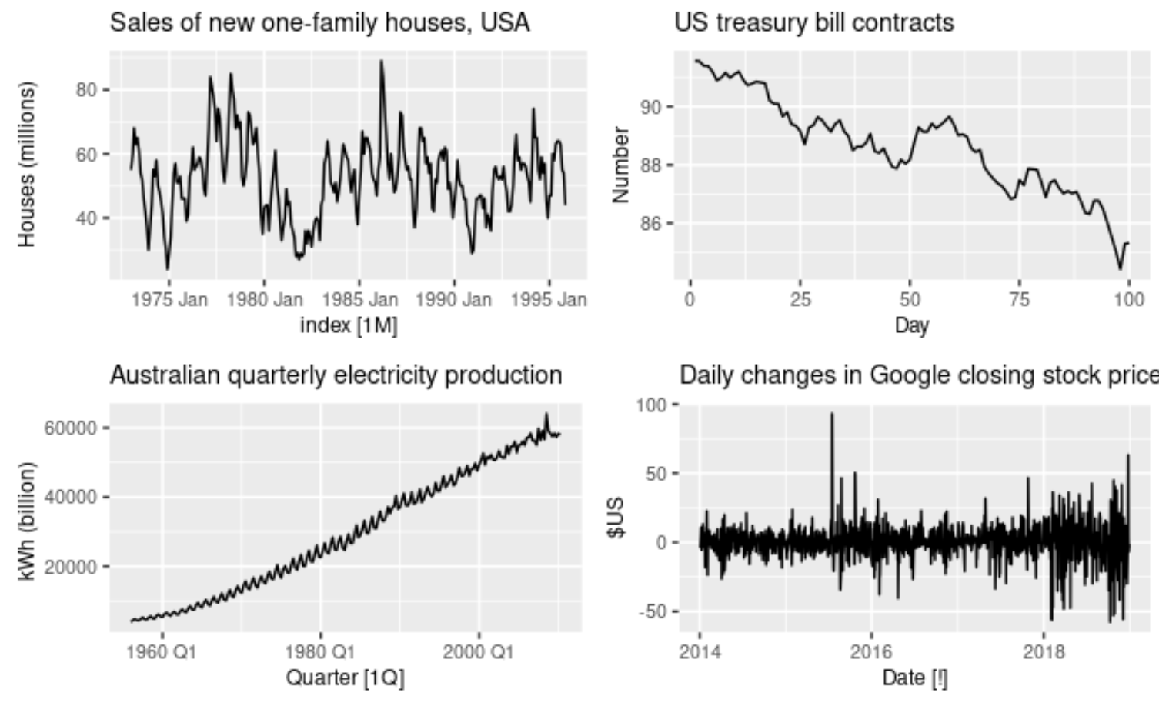
Simple Exponential Smoothing Method
Simplest of the exponential smoothing methods
Suitable for forecasting time series with no clear trend and seasonality
Therefore, it only uses the level component of the time series

Slide 11
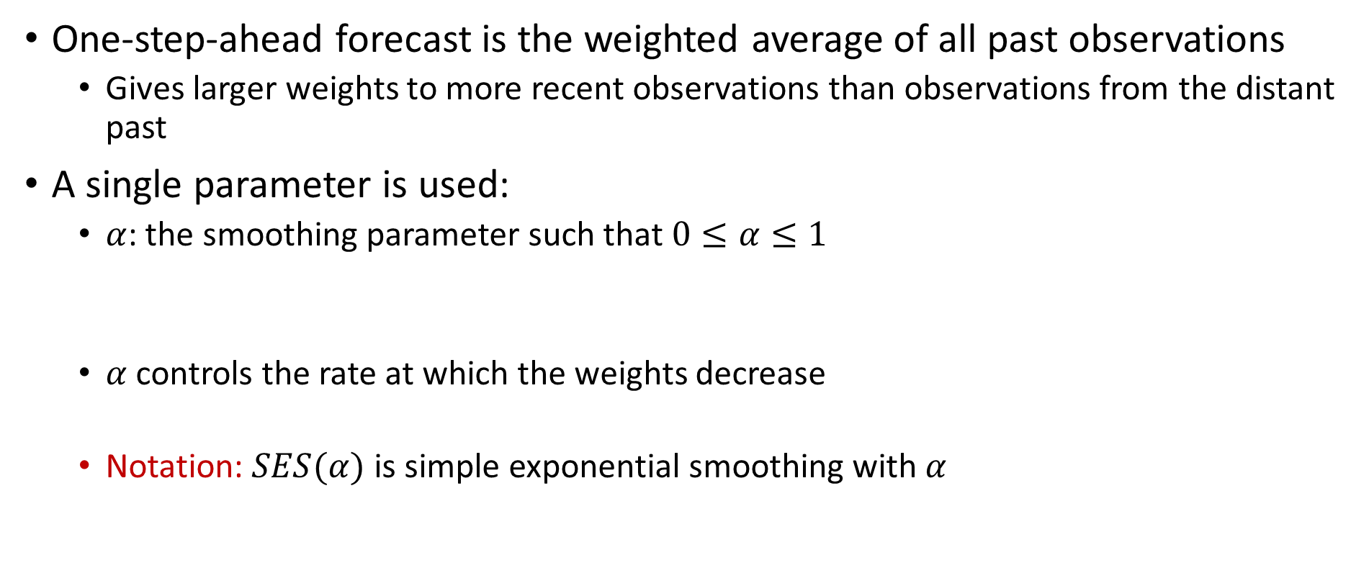
Simple Exponential Smoothing Method
One-step-ahead forecast is the weighted average of all past observations
  Gives larger weights to more recent observations than observations from the distant past
A single parameter is used:
  $α$: the smoothing parameter such that $0≤α≤1$
  $α$ controls the rate at which the weights decrease
  Notation: $SES(α)$ is simple exponential smoothing with $α$
$${\hat{y}}_{T+1|T}=αy_{T}+α\left(1−α\right)y_{T−1}+α{\left(1−α\right)}^{2}y_{T−2}+…$$

Slide 12
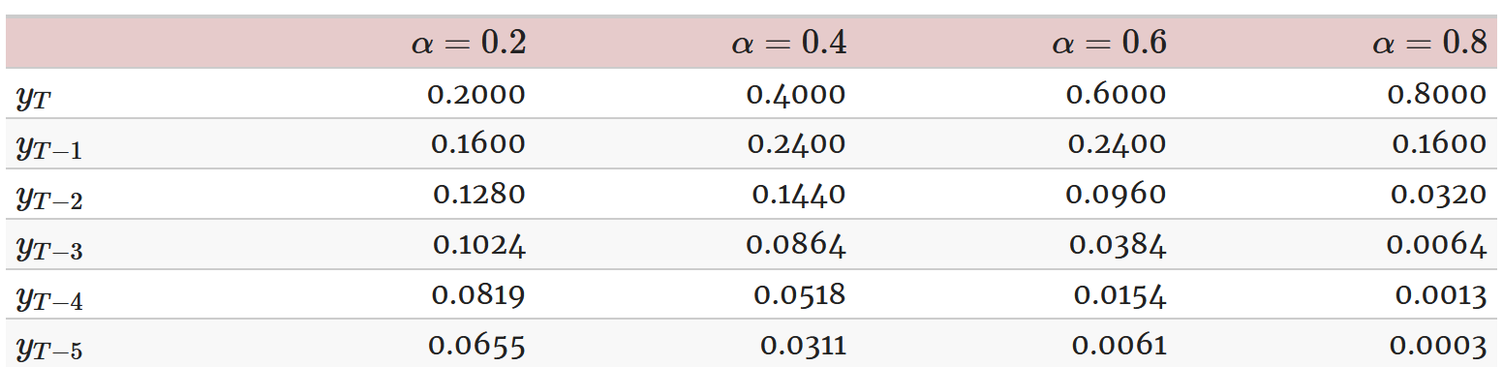
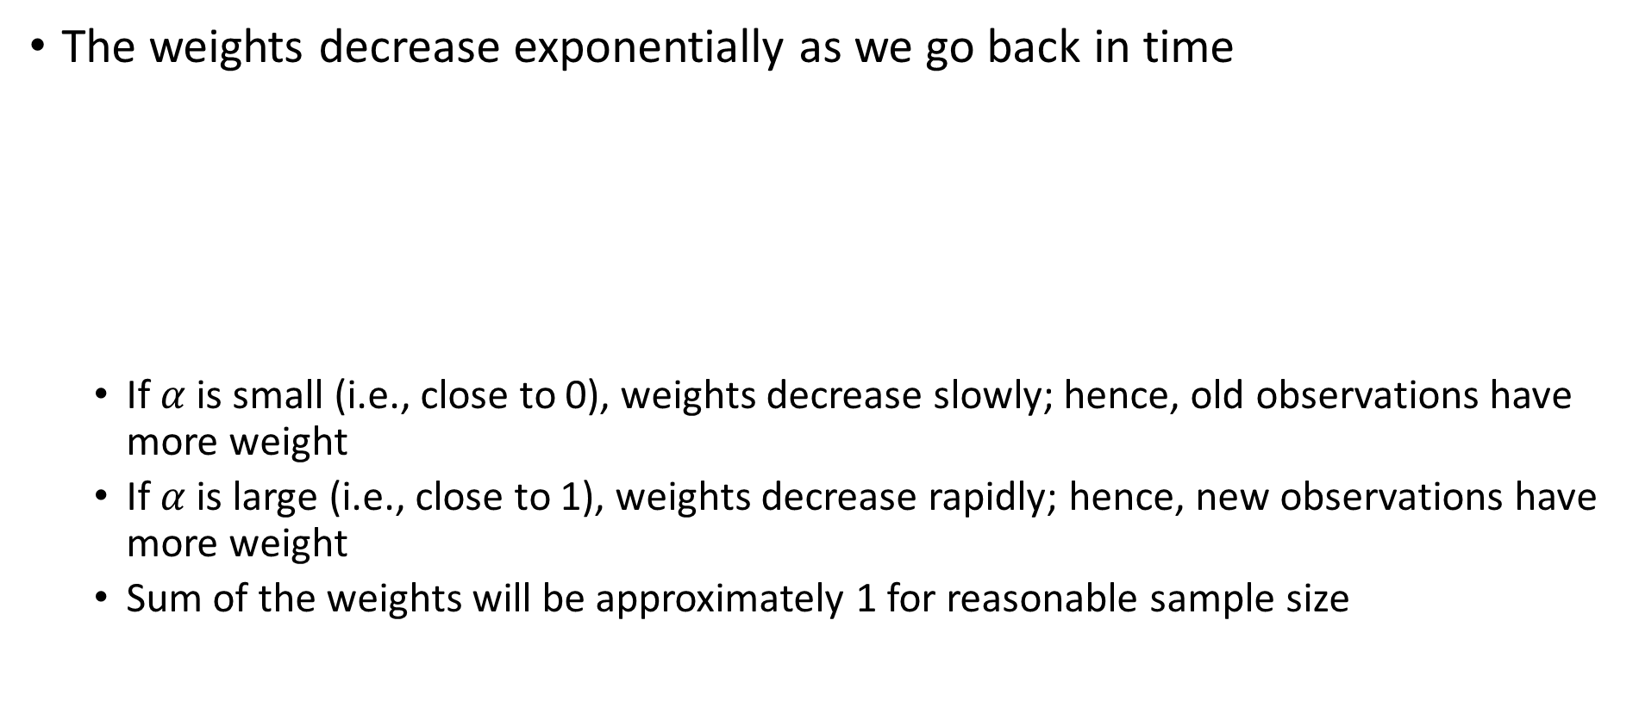
Simple Exponential Smoothing Method
The weights decrease exponentially as we go back in time
  If $α$ is small (i.e., close to 0), weights decrease slowly; hence, old observations have more weight
  If $α$ is large (i.e., close to 1), weights decrease rapidly; hence, new observations have more weight
  Sum of the weights will be approximately 1 for reasonable sample size

Slide 13

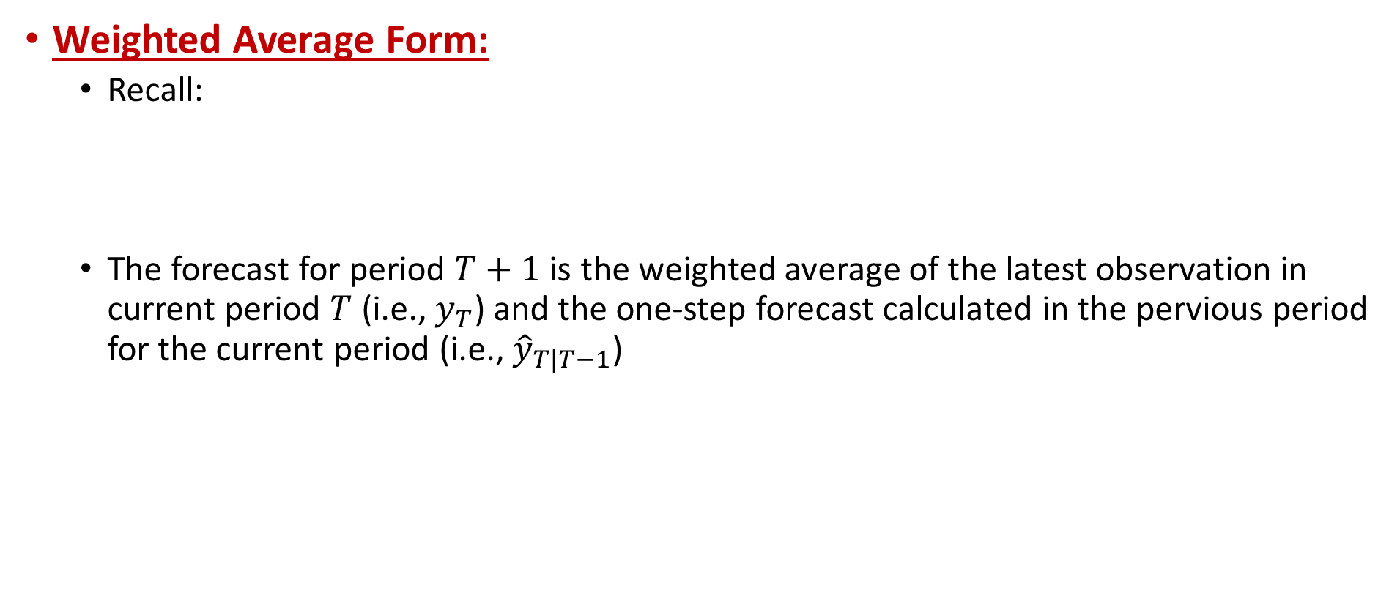

Simple Exponential Smoothing Forms
Weighted Average Form:
  Recall:
  The forecast for period $T+1$ is the weighted average of the latest observation in current period $T$ (i.e., $y_{T}$) and the one-step forecast calculated in the pervious period for the current period (i.e., ${\hat{y}}_{T|T−1}$)
$${\hat{y}}_{T+1|T}=αy_{T}+α\left(1−α\right)y_{T−1}+α{\left(1−α\right)}^{2}y_{T−2}+…$$
$$(1−α){\hat{y}}_{T|T−1}$$
$${\hat{y}}_{T+1|T}=αy_{T}+α\left(1−α\right){\hat{y}}_{T|T−1}$$

Slide 14
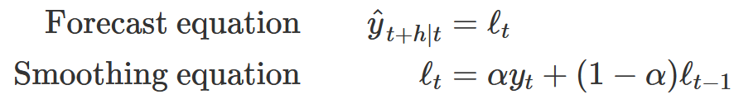
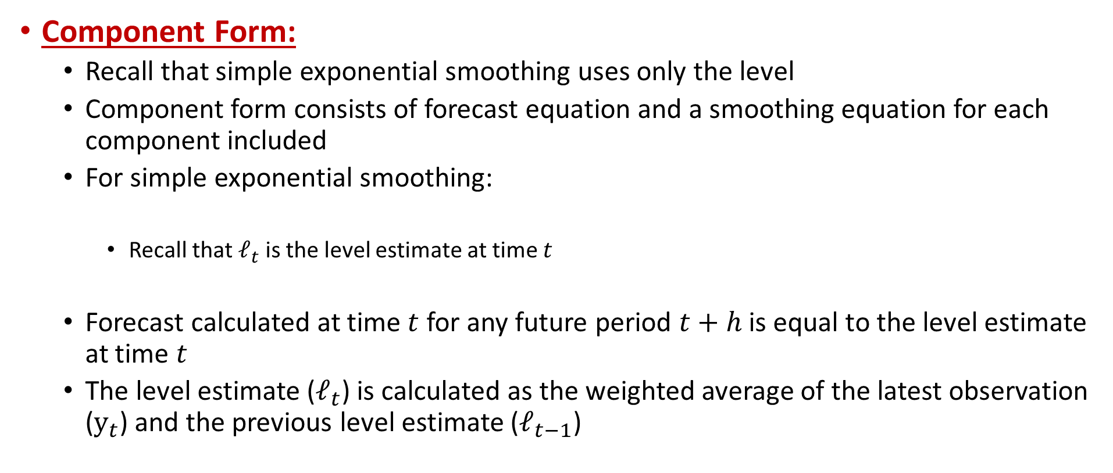
Simple Exponential Smoothing Forms
Component Form:
  Recall that simple exponential smoothing uses only the level
  Component form consists of forecast equation and a smoothing equation for each component included
  For simple exponential smoothing:
    Recall that $ℓ_{t}$ is the level estimate at time $t$
  Forecast calculated at time $t$ for any future period $t+h$ is equal to the level estimate at time $t$
  The level estimate ($ℓ_{t}$) is calculated as the weighted average of the latest observation ($y_{t}$) and the previous level estimate ($ℓ_{t−1}$)

Slide 15







Simple Exponential Smoothing Forms
Component Form:
  When we observe a new data point, we update the estimate for the level and use the updated level information
    Value for period $T+1$ is observed
    → update estimate level
    → update forecasts for $T+1+h$
$y_{T+1}$ is observed
$$ℓ_{T+1}=αy_{T+1}+(1−α)ℓ_{T}$$
$${\hat{y}}_{T+1+h|T+1}=ℓ_{T+1}$$
$$=αy_{T+1}+(1−α)ℓ_{T}$$
$$=αy_{T+1}+(1−α){\hat{y}}_{T+1|T}$$

Slide 16
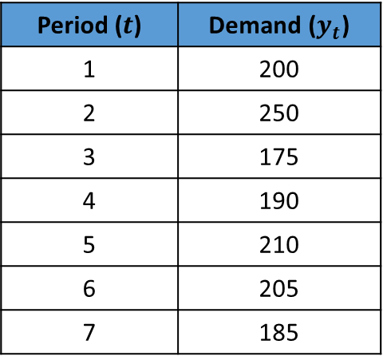

SES Example
Demand forecasting with SES
  The demand data is given below
  We are in period 7, and observed the demand to be 185 units
  Given we’re in period 7, what are the forecasts for period 8, 9, & 10?
  That is, what are ${\hat{y}}_{8|7}$, ${\hat{y}}_{9|7}$, and ${\hat{y}}_{10|7}$?
Period ($t$) | Demand ($y_{t}$)
1 | 200
2 | 250
3 | 175
4 | 190
5 | 210
6 | 205
7 | 185

Slide 17
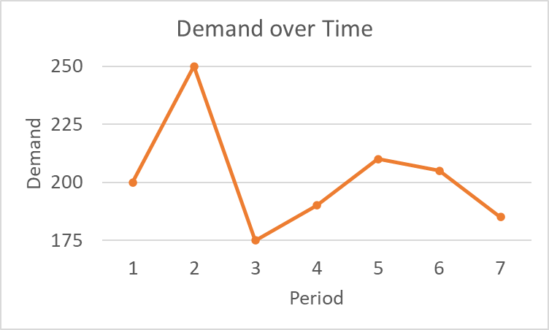

SES Example
Demand forecasting with SES
  The demand data has no trend and no seasonality
    Limited data to conclude a specific pattern though!
  We’ll use simple exponential smoothing with $α=0.6$, i.e. $SES(0.6)$
Period ($t$) | Demand ($y_{t}$)
1 | 200
2 | 250
3 | 175
4 | 190
5 | 210
6 | 205
7 | 185

Slide 18
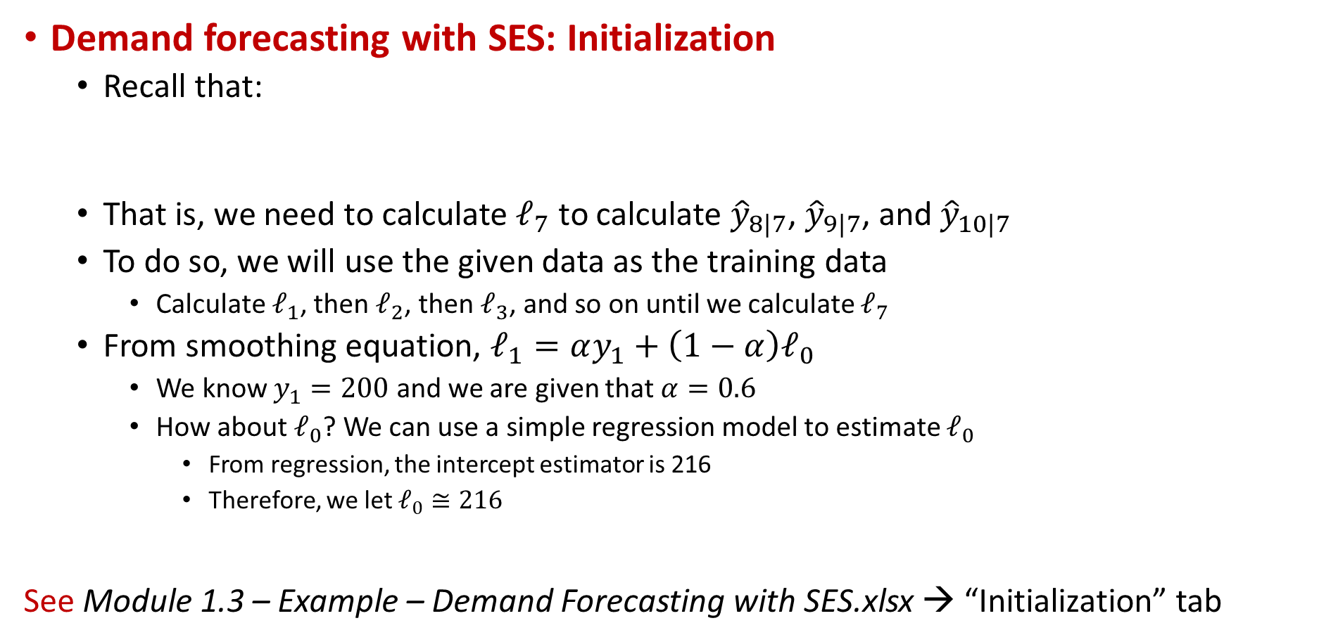
SES Example: Initialization
Demand forecasting with SES: Initialization
  Recall that:
  That is, we need to calculate $ℓ_{7}$ to calculate ${\hat{y}}_{8|7}$, ${\hat{y}}_{9|7}$, and ${\hat{y}}_{10|7}$
  To do so, we will use the given data as the training data
    Calculate $ℓ_{1}$, then $ℓ_{2}$, then $ℓ_{3}$, and so on until we calculate $ℓ_{7}$
  From smoothing equation, $ℓ_{1}=αy_{1}+\left(1−α\right)ℓ_{0}$
    We know $y_{1}=200$ and we are given that $α=0.6$
    How about $ℓ_{0}$? We can use a simple regression model to estimate $ℓ_{0}$
      From regression, the intercept estimator is 216
      Therefore, we let $ℓ_{0}≅216$
See Module 1.3 – Example – Demand Forecasting with SES.xlsx → “Initialization” tab

Slide 19
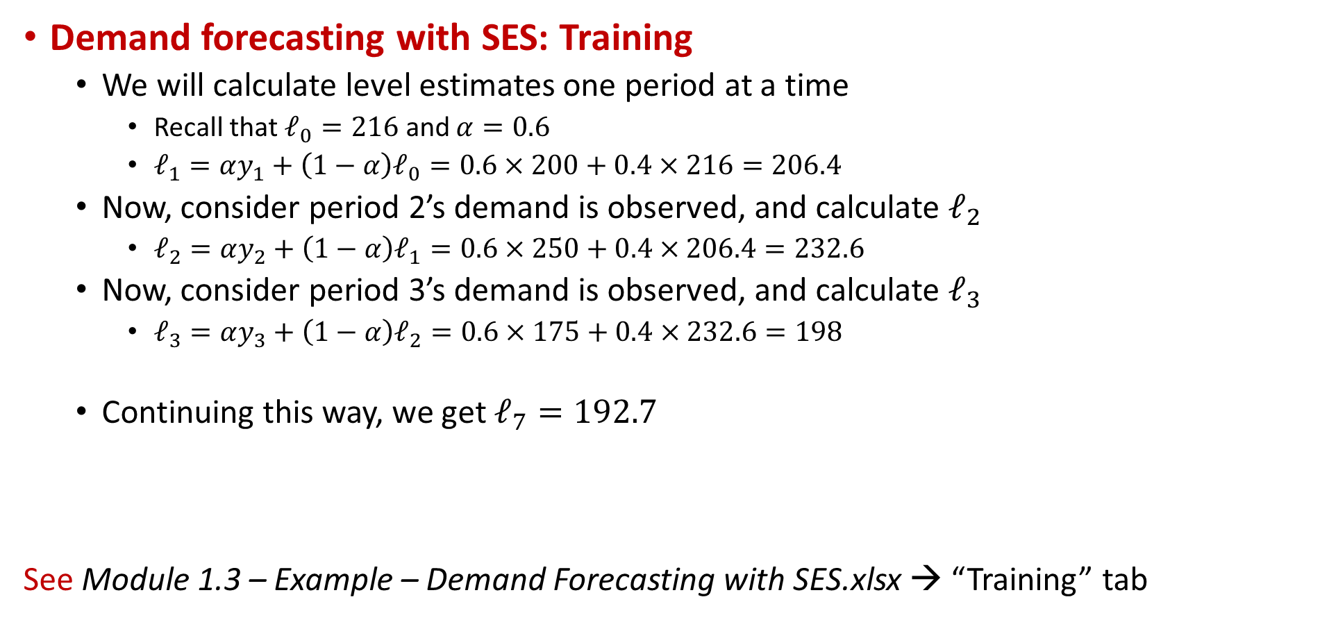
SES Example: Training
Demand forecasting with SES: Training
  We will calculate level estimates one period at a time
    Recall that $ℓ_{0}=216$ and $α=0.6$
    $ℓ_{1}=αy_{1}+\left(1−α\right)ℓ_{0}=0.6×200+0.4×216=206.4$
  Now, consider period 2’s demand is observed, and calculate $ℓ_{2}$
    $ℓ_{2}=αy_{2}+\left(1−α\right)ℓ_{1}=0.6×250+0.4×206.4=232.6$
  Now, consider period 3’s demand is observed, and calculate $ℓ_{3}$
    $ℓ_{3}=αy_{3}+\left(1−α\right)ℓ_{2}=0.6×175+0.4×232.6=198$
  Continuing this way, we get $ℓ_{7}=192.7$
See Module 1.3 – Example – Demand Forecasting with SES.xlsx → “Training” tab

Slide 20
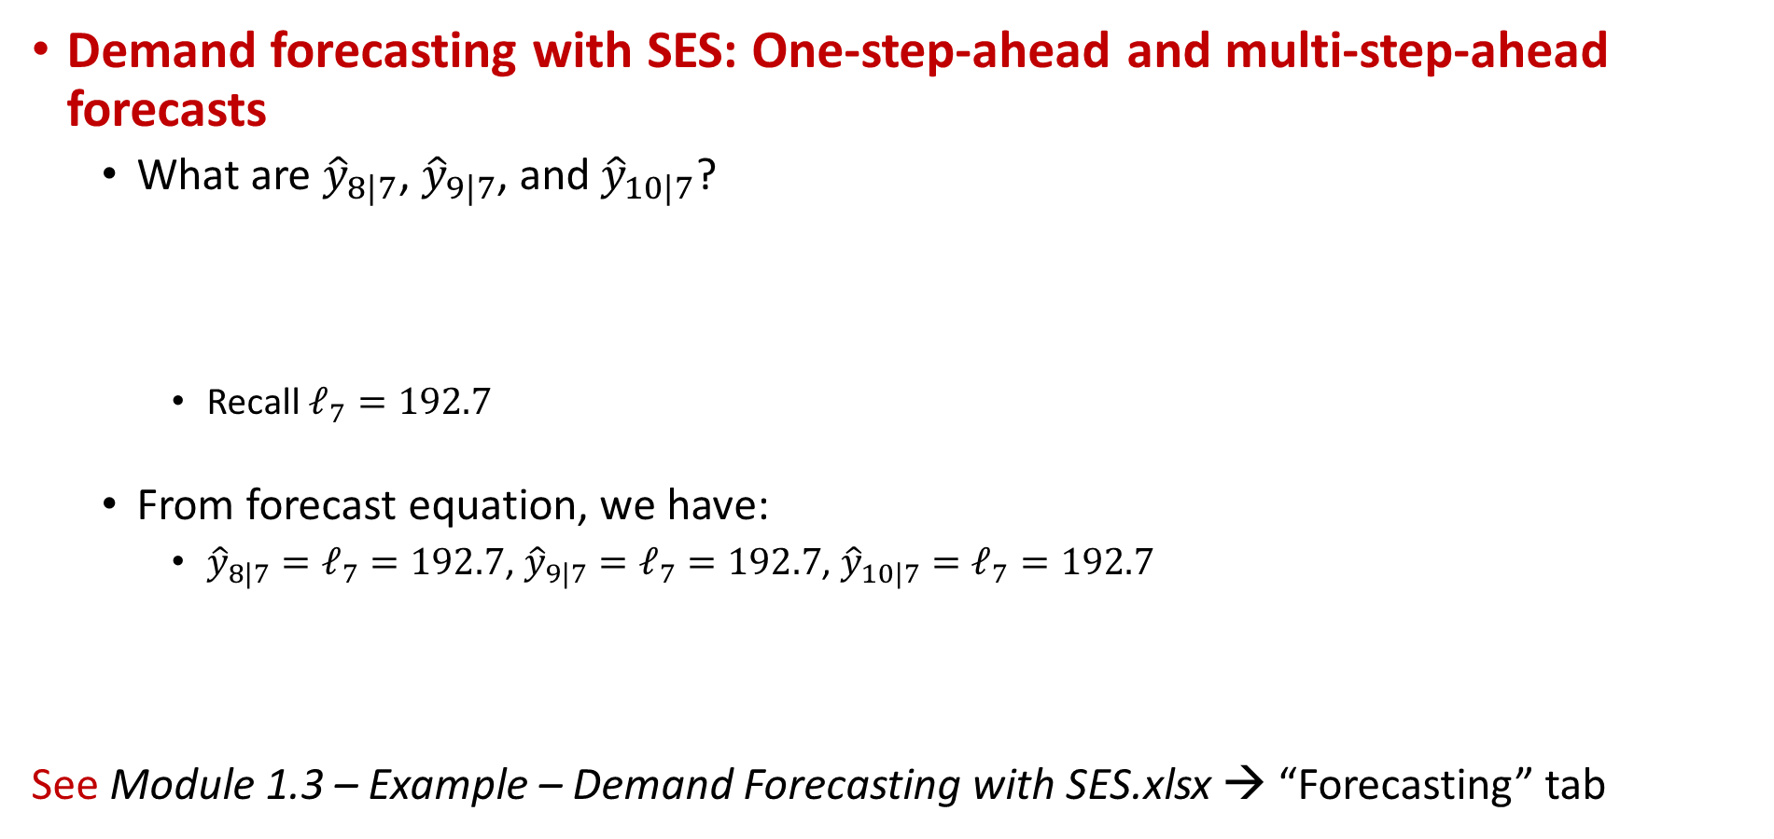
SES Example: Forecasting
Demand forecasting with SES: One-step-ahead and multi-step-ahead forecasts
  What are ${\hat{y}}_{8|7}$, ${\hat{y}}_{9|7}$, and ${\hat{y}}_{10|7}$?
    Recall $ℓ_{7}=192.7$
  From forecast equation, we have:
    ${\hat{y}}_{8|7}=ℓ_{7}=192.7$, ${\hat{y}}_{9|7}=ℓ_{7}=192.7$, ${\hat{y}}_{10|7}=ℓ_{7}=192.7$
See Module 1.3 – Example – Demand Forecasting with SES.xlsx → “Forecasting” tab

Slide 21
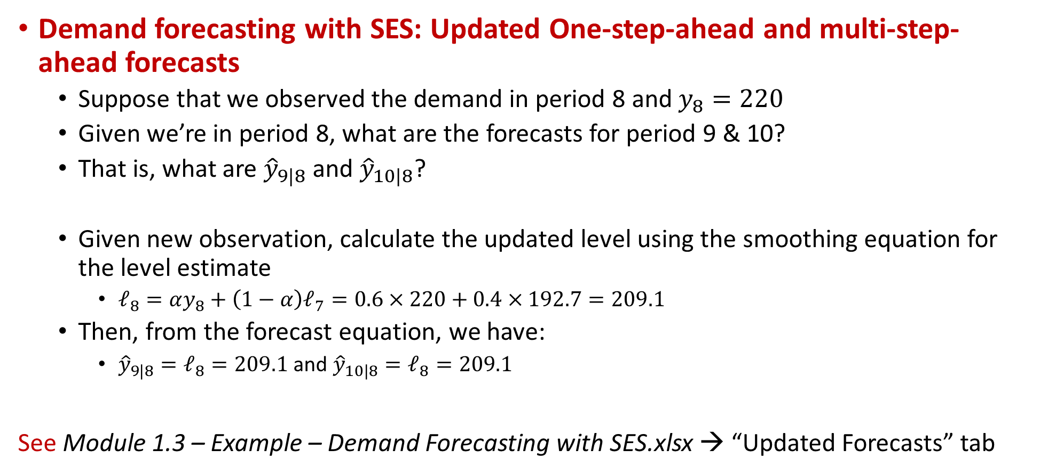
SES Example: Updated Forecasts
Demand forecasting with SES: Updated One-step-ahead and multi-step-ahead forecasts
  Suppose that we observed the demand in period 8 and $y_{8}=220$
  Given we’re in period 8, what are the forecasts for period 9 & 10?
  That is, what are ${\hat{y}}_{9|8}$ and ${\hat{y}}_{10|8}$?
  Given new observation, calculate the updated level using the smoothing equation for the level estimate
    $ℓ_{8}=αy_{8}+\left(1−α\right)ℓ_{7}=0.6×220+0.4×192.7=209.1$
  Then, from the forecast equation, we have:
    ${\hat{y}}_{9|8}=ℓ_{8}=209.1$ and ${\hat{y}}_{10|8}=ℓ_{8}=209.1$
See Module 1.3 – Example – Demand Forecasting with SES.xlsx → “Updated Forecasts” tab

Slide 22
Insights and Optimization
See Module 1.3 – Example – SES Insights and Optimization.xlsx
Key-point: When using Exponential Smoothing method, the forecast made for the next period's demand is weighted average of the current demand observation and the previous forecast made for the current period's demand.
Key-point: At the end of a period, one-step-ahead and multi-step-ahead forecasts made using Exponential Smoothing method are identical because, the underlying assumption is that the demand has no trend and no seasonality.

Slide 23
Insights and Optimization
See Module 1.3 – Example – SES Insights and Optimization.xlsx
Key-point: Exponential Smoothing method is suitable for data with no observable trend. If Exponential Smoothing method is used for a time-series with trend, the forecasts made will lag the trend.
The smaller alpha is used, the bigger the gap will be
This is because, with larger alpha, you can capture the trend better as you give larger weight to the newer observations

Slide 24
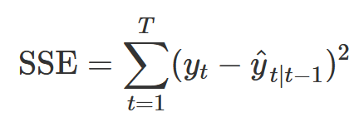
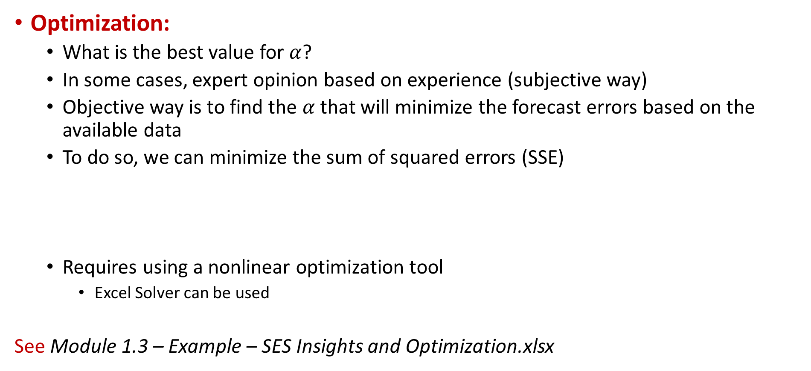
Insights and Optimization
Optimization:
  What is the best value for $α$?
  In some cases, expert opinion based on experience (subjective way)
  Objective way is to find the $α$ that will minimize the forecast errors based on the available data
  To do so, we can minimize the sum of squared errors (SSE)
  Requires using a nonlinear optimization tool
    Excel Solver can be used
See Module 1.3 – Example – SES Insights and Optimization.xlsx

Slide 25
Exponential Smoothing Method
Exponential Smoothing Method:
  Advantages: Easily understood and computed & provides stable forecasts & needs data of the last period
  Disadvantages: Lags trends & ignores complexity & do not forget the past
Moving Average vs. Exponential Smoothing:
  Similarities: Appropriate for stationary series (randomness, no trend, no seasonality) & Dependency on a single parameter (N and α) & Lagging the trends in the data
  Differences: MA forgets the past data after N periods, however, ES carries all the past data & ES requires only the forecast and the observation of the previous period, however, MA requires all N past observations
  Both methods are not suitable when the data has trends and/or seasonality.

Slide 26
Outline
Exponential Smoothing Methods
  Introduction and Notation
Simple Exponential Smoothing
  Forms and Equations, and Example
  Insights and Optimization
Holt’s Linear Trend Method
  Equations and Example
  Insights, Optimization, and Damping
Holt-Winters’ Seasonal Method
  Equations and Example
  Multiplicative and Damped method
Taxonomy of ETS Methods

Slide 27
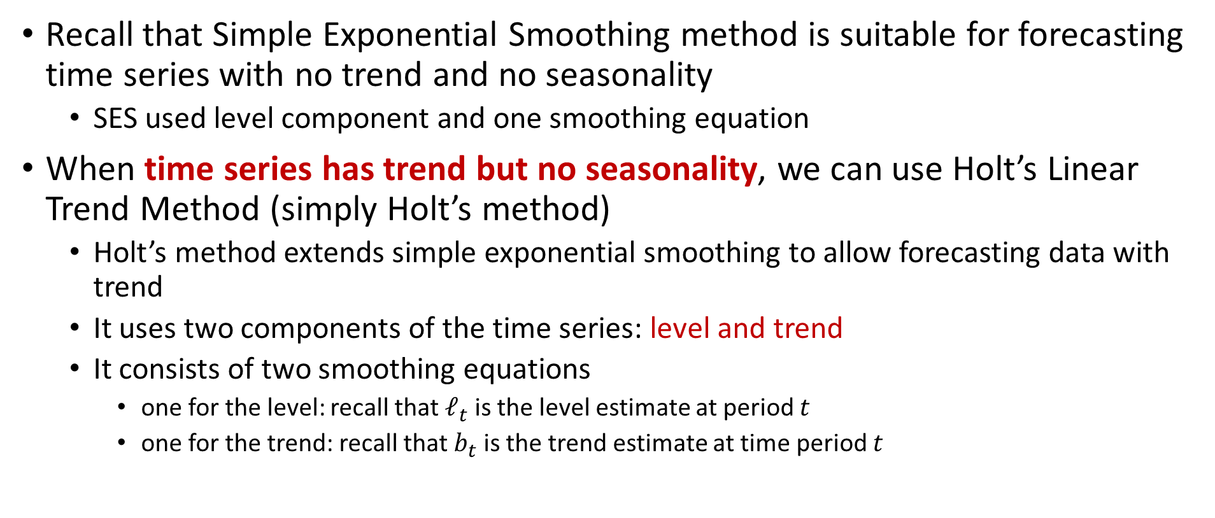
Holt’s Linear Trend Method
Recall that Simple Exponential Smoothing method is suitable for forecasting time series with no trend and no seasonality
  SES used level component and one smoothing equation
When time series has trend but no seasonality, we can use Holt’s Linear Trend Method (simply Holt’s method)
  Holt’s method extends simple exponential smoothing to allow forecasting data with trend
  It uses two components of the time series: level and trend
  It consists of two smoothing equations
    one for the level: recall that $ℓ_{t}$ is the level estimate at period 𝑡
    one for the trend: recall that $b_{t}$ is the trend estimate at time period 𝑡

Slide 28

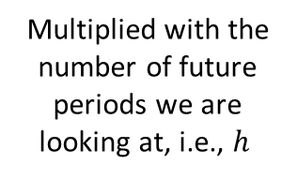
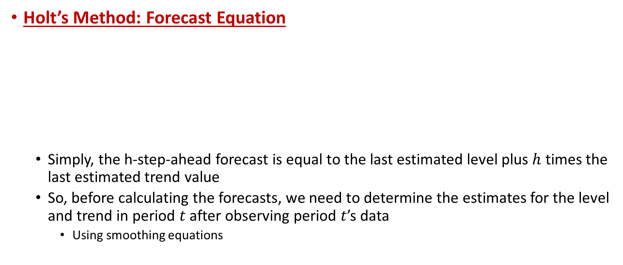
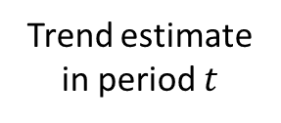
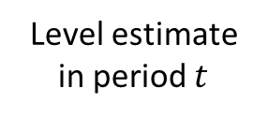
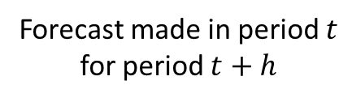
Holt’s Linear Trend Method
Holt’s Method: Forecast Equation
  Simply, the h-step-ahead forecast is equal to the last estimated level plus $h$ times the last estimated trend value
  So, before calculating the forecasts, we need to determine the estimates for the level and trend in period 𝑡 after observing period 𝑡’s data
    Using smoothing equations
Forecast made in period $t$ for period $t+h$
Multiplied with the number of future periods we are looking at, i.e., $h$
Level estimate in period $t$
Trend estimate in period $t$

Slide 29



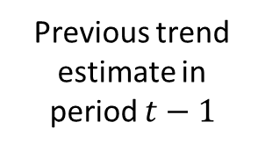


Holt’s Linear Trend Method
Holt’s Method: Smoothing Equations
$α$ is the smoothing parameter for level, $0≤α≤1$
First, calculate the latest level estimate, then calculate the latest trend estimate
Observed value of period $t$
One-step-ahead forecast for period $t$ made in period $t−1$
$β^{∗}$ is the smoothing parameter for trend, $0≤β^{∗}≤1$
Estimated trend moving from period $(t−1)$ to $t$
Previous trend estimate in period $t−1$

Slide 30
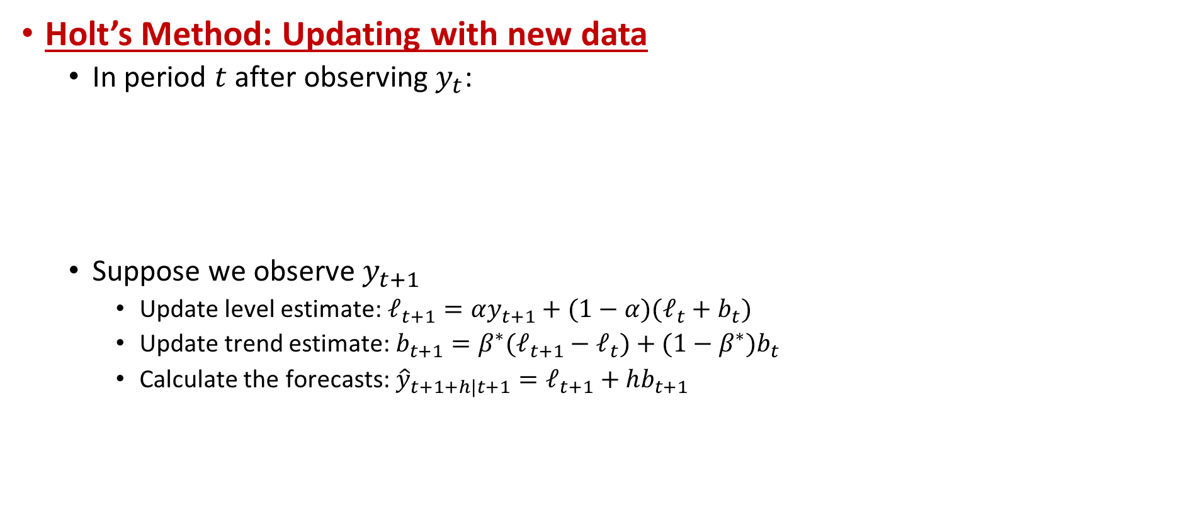
Holt’s Linear Trend Method
Holt’s Method: Updating with new data
  In period $t$ after observing $y_{t}$:
  Suppose we observe $y_{t+1}$
    Update level estimate: $ℓ_{t+1}=αy_{t+1}+(1−α)(ℓ_{t}+b_{t})$
    Update trend estimate: $b_{t+1}=β^{∗}(ℓ_{t+1}−ℓ_{t})+(1−β^{∗})b_{t}$
    Calculate the forecasts: ${\hat{y}}_{t+1+h|t+1}=ℓ_{t+1}+hb_{t+1}$

Slide 31
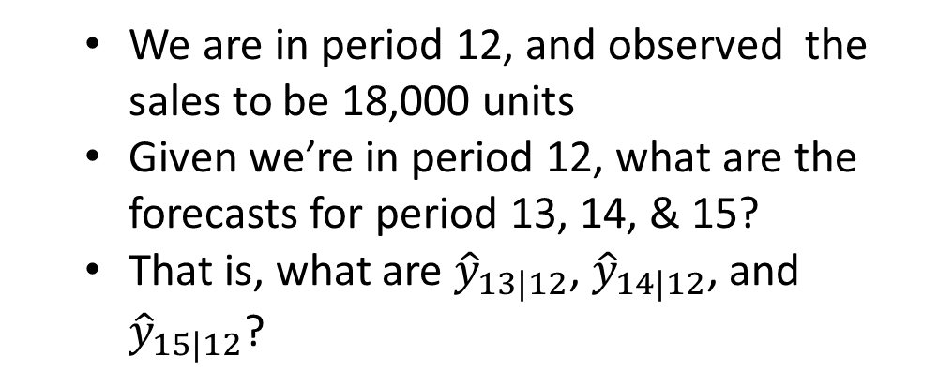
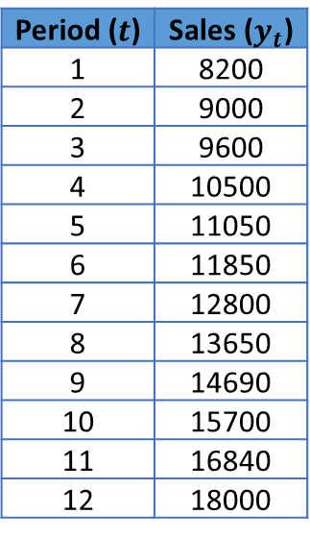
Holt’s Method Example
Sales forecasting with Holt’s Method
  The sales data is given below
Period ($t$) | Sales ($y_{t}$)
1 | 8200
2 | 9000
3 | 9600
4 | 10500
5 | 11050
6 | 11850
7 | 12800
8 | 13650
9 | 14690
10 | 15700
11 | 16840
12 | 18000
  We are in period 12, and observed the sales to be 18,000 units
  Given we’re in period 12, what are the forecasts for period 13, 14, & 15?
  That is, what are ${\hat{y}}_{13|12}$, ${\hat{y}}_{14|12}$, and ${\hat{y}}_{15|12}$?

Slide 32
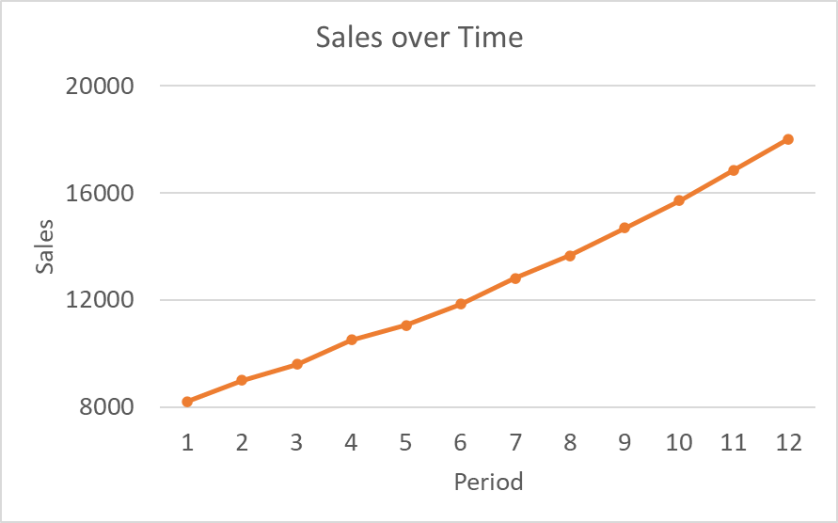

Holt’s Method Example
Sales forecasting with Holt’s Method
  The sales data has an increasing trend and no seasonality
  We’ll use Holt’s method with $α=0.1$ and $β^{∗}=0.2$
Period ($t$) | Sales ($y_{t}$)
1 | 8200
2 | 9000
3 | 9600
4 | 10500
5 | 11050
6 | 11850
7 | 12800
8 | 13650
9 | 14690
10 | 15700
11 | 16840
12 | 18000

Slide 33
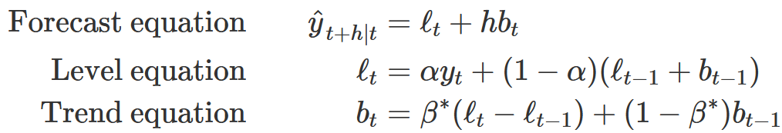
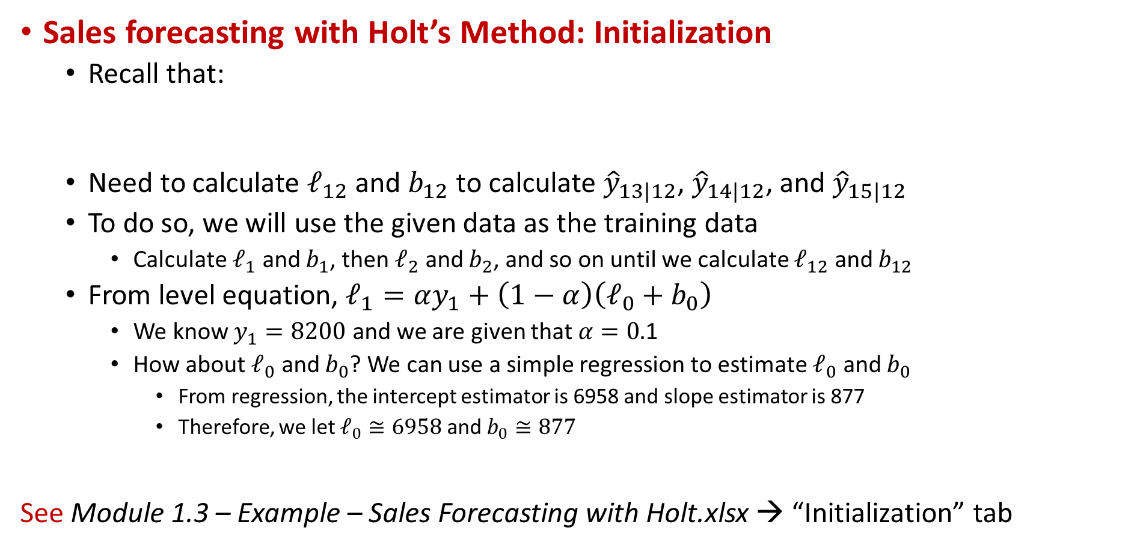
Holt’s Example: Initialization
Sales forecasting with Holt’s Method: Initialization
  Recall that:
  Need to calculate $ℓ_{12}$ and $b_{12}$ to calculate ${\hat{y}}_{13|12}$, ${\hat{y}}_{14|12}$, and ${\hat{y}}_{15|12}$
  To do so, we will use the given data as the training data
    Calculate $ℓ_{1}$ and $b_{1}$, then $ℓ_{2}$ and $b_{2}$, and so on until we calculate $ℓ_{12}$ and $b_{12}$
  From level equation, $ℓ_{1}=αy_{1}+\left(1−α\right)\left(ℓ_{0}+b_{0}\right)$
    We know $y_{1}=8200$ and we are given that $α=0.$1
    How about $ℓ_{0}$ and $b_{0}$? We can use a simple regression to estimate $ℓ_{0}$ and $b_{0}$
      From regression, the intercept estimator is 6958 and slope estimator is 877
      Therefore, we let $ℓ_{0}≅\text{6958}$ and $b_{0}≅\text{877}$
See Module 1.3 – Example – Sales Forecasting with Holt.xlsx → “Initialization” tab

Slide 34
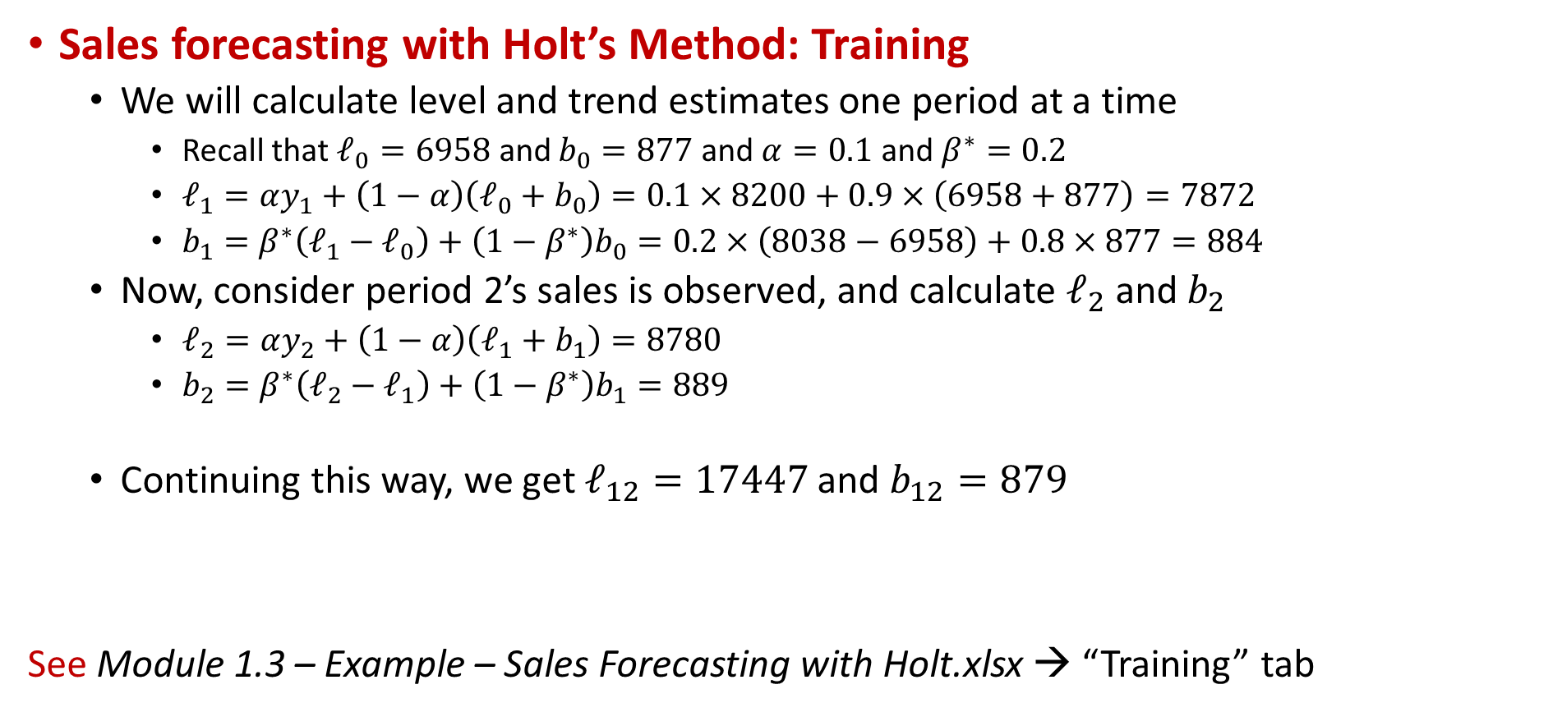
Holt’s Example: Training
Sales forecasting with Holt’s Method: Training
  We will calculate level and trend estimates one period at a time
    Recall that $ℓ_{0}=6958$ and $b_{0}=877$ and $α=0.1$ and $β^{∗}=0.2$
    $ℓ_{1}=αy_{1}+\left(1−α\right)\left(ℓ_{0}+b_{0}\right)=0.1×8200+0.9×\left(6958+877\right)=7872$
    $b_{1}=β^{∗}\left(ℓ_{1}−ℓ_{0}\right)+\left(1−β^{∗}\right)b_{0}=0.2×\left(8038−6958\right)+0.8×877=884$
  Now, consider period 2’s sales is observed, and calculate $ℓ_{2}$ and $b_{2}$
    $ℓ_{2}=αy_{2}+\left(1−α\right)\left(ℓ_{1}+b_{1}\right)=8780$
    $b_{2}=β^{∗}\left(ℓ_{2}−ℓ_{1}\right)+\left(1−β^{∗}\right)b_{1}=889$
  Continuing this way, we get $ℓ_{12}=17447$ and $b_{12}=879$
See Module 1.3 – Example – Sales Forecasting with Holt.xlsx → “Training” tab

Slide 35
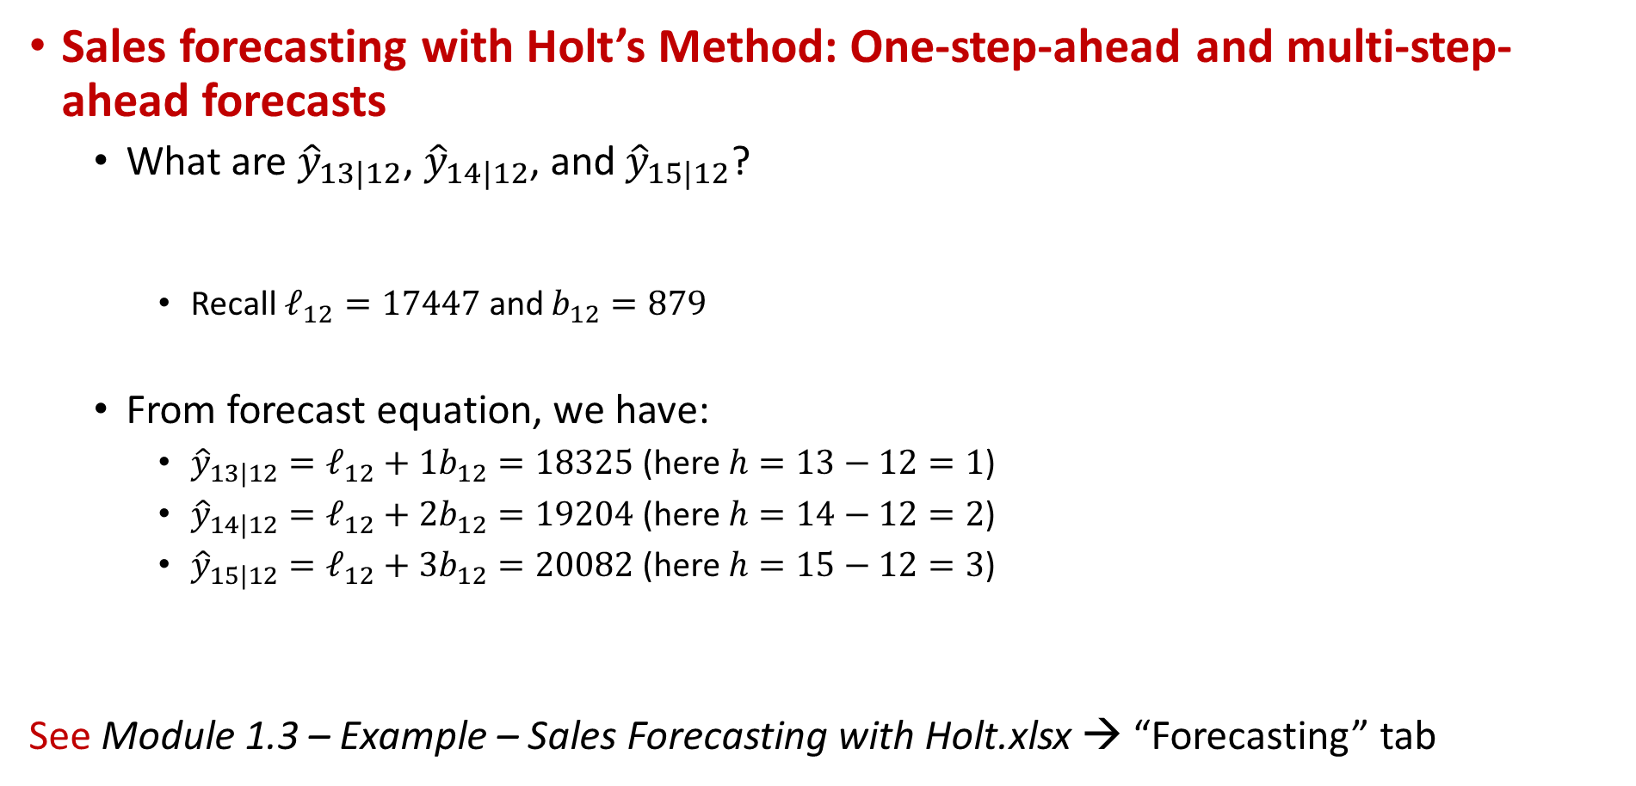
Holt’s Example: Forecasting
Sales forecasting with Holt’s Method: One-step-ahead and multi-step-ahead forecasts
  What are ${\hat{y}}_{13|12}$, ${\hat{y}}_{14|12}$, and ${\hat{y}}_{15|12}$?
    Recall $ℓ_{12}=17447$ and $b_{12}=879$
  From forecast equation, we have:
    ${\hat{y}}_{13|12}=ℓ_{12}+1b_{12}=18325$ (here $h=13−12=1$)
    ${\hat{y}}_{14|12}=ℓ_{12}+2b_{12}=19204$ (here $h=14−12=2$)
    ${\hat{y}}_{15|12}=ℓ_{12}+3b_{12}=20082$ (here $h=15−12=3$)
See Module 1.3 – Example – Sales Forecasting with Holt.xlsx → “Forecasting” tab

Slide 36
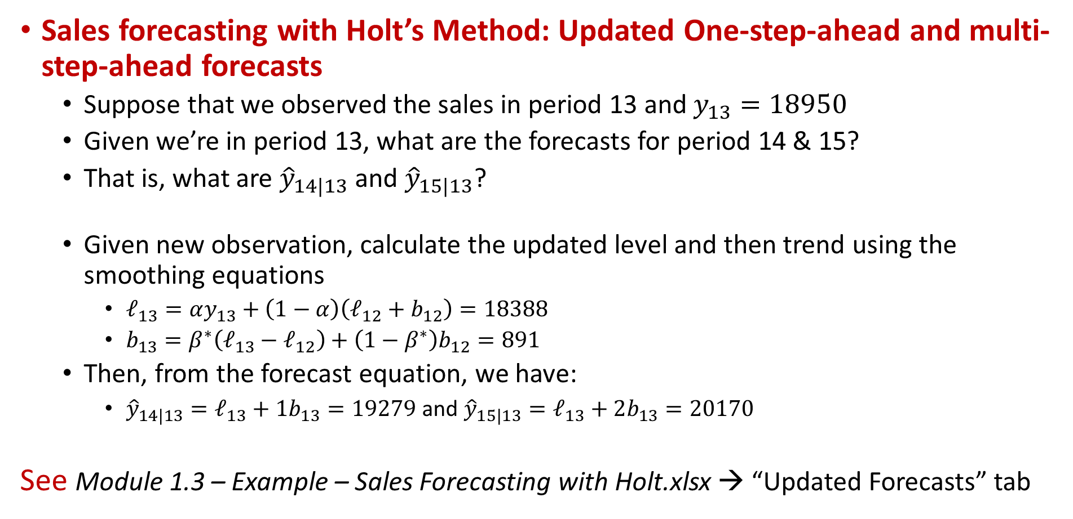
Holt’s Example: Updated Forecasts
Sales forecasting with Holt’s Method: Updated One-step-ahead and multi-step-ahead forecasts
  Suppose that we observed the sales in period 13 and $y_{13}=18950$
  Given we’re in period 13, what are the forecasts for period 14 & 15?
  That is, what are ${\hat{y}}_{14|13}$ and ${\hat{y}}_{15|13}$?
  Given new observation, calculate the updated level and then trend using the smoothing equations
    $ℓ_{13}=αy_{13}+\left(1−α\right)\left(ℓ_{12}+b_{12}\right)=18388$
    $b_{13}=β^{∗}\left(ℓ_{13}−ℓ_{12}\right)+\left(1−β^{∗}\right)b_{12}=891$
  Then, from the forecast equation, we have:
    ${\hat{y}}_{14|13}=ℓ_{13}+1b_{13}=19279$ and ${\hat{y}}_{15|13}=ℓ_{13}+2b_{13}=20170$
See Module 1.3 – Example – Sales Forecasting with Holt.xlsx → “Updated Forecasts” tab

Slide 37
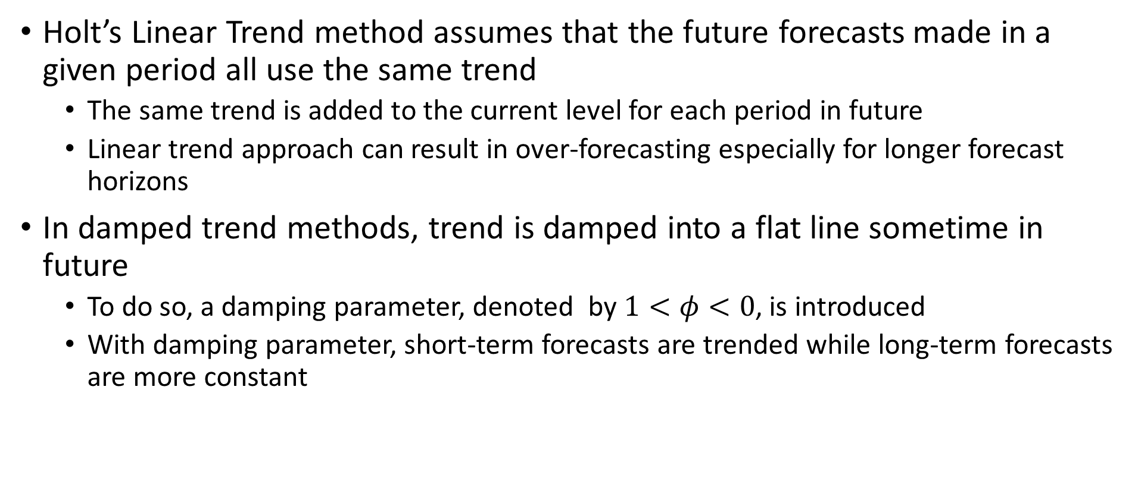
Damped Trend Method
Holt’s Linear Trend method assumes that the future forecasts made in a given period all use the same trend
  The same trend is added to the current level for each period in future
  Linear trend approach can result in over-forecasting especially for longer forecast horizons
In damped trend methods, trend is damped into a flat line sometime in future
  To do so, a damping parameter, denoted by $1<φ<0$, is introduced
  With damping parameter, short-term forecasts are trended while long-term forecasts are more constant

Slide 38
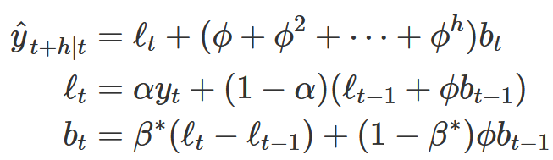
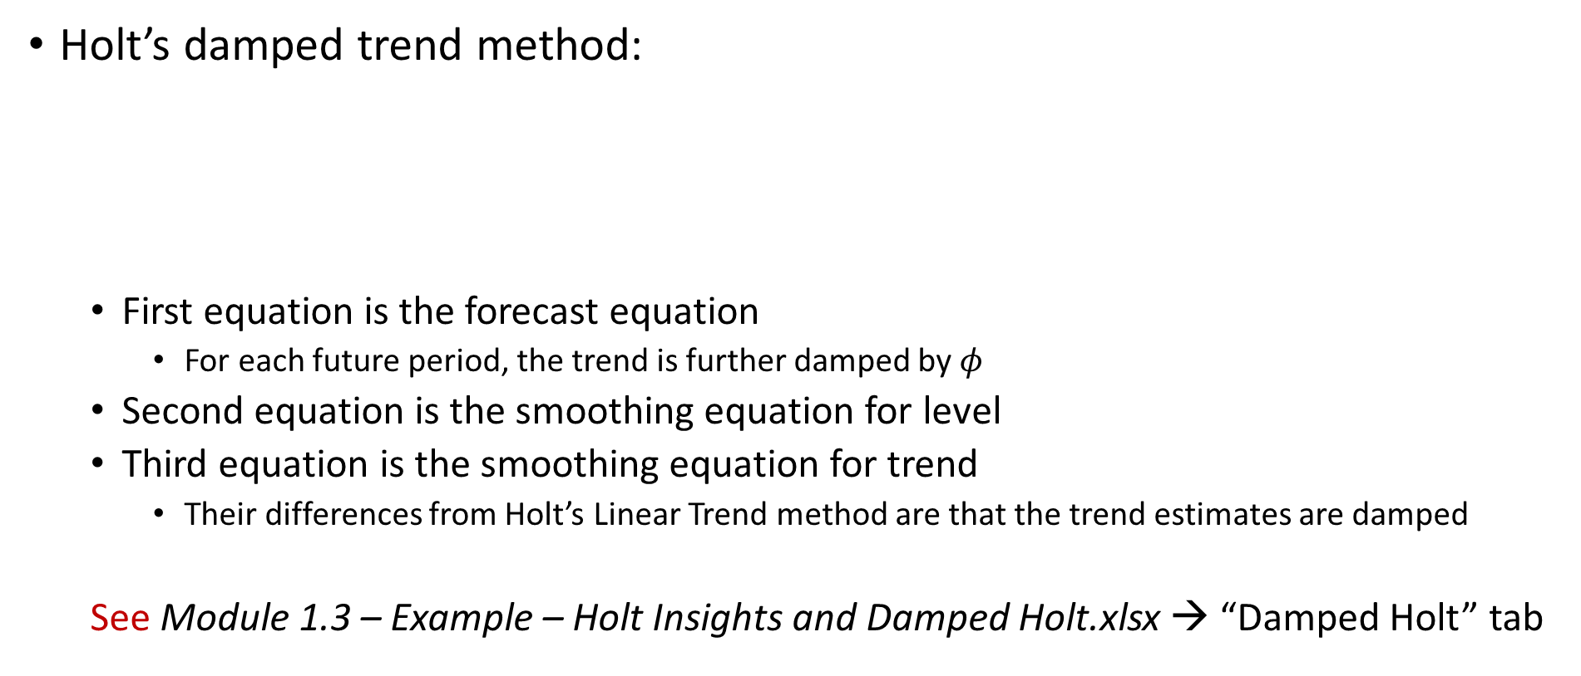
Damped Trend Method
Holt’s damped trend method:
  First equation is the forecast equation
    For each future period, the trend is further damped by $φ$
  Second equation is the smoothing equation for level
  Third equation is the smoothing equation for trend
    Their differences from Holt’s Linear Trend method are that the trend estimates are damped
  See Module 1.3 – Example – Holt Insights and Damped Holt.xlsx → “Damped Holt” tab

Slide 39
Insights and Optimization
Unlike simple exponential smoothing, methods with trend do not result in flat forecasts
  That is, one-step-ahead and multi-step-ahead forecasts are not identical
  This is expected because the trend is captured by methods with trend
  See Module 1.3 – Example – Holt Insights and Damped Holt.xlsx → “Insights” tab

Slide 40
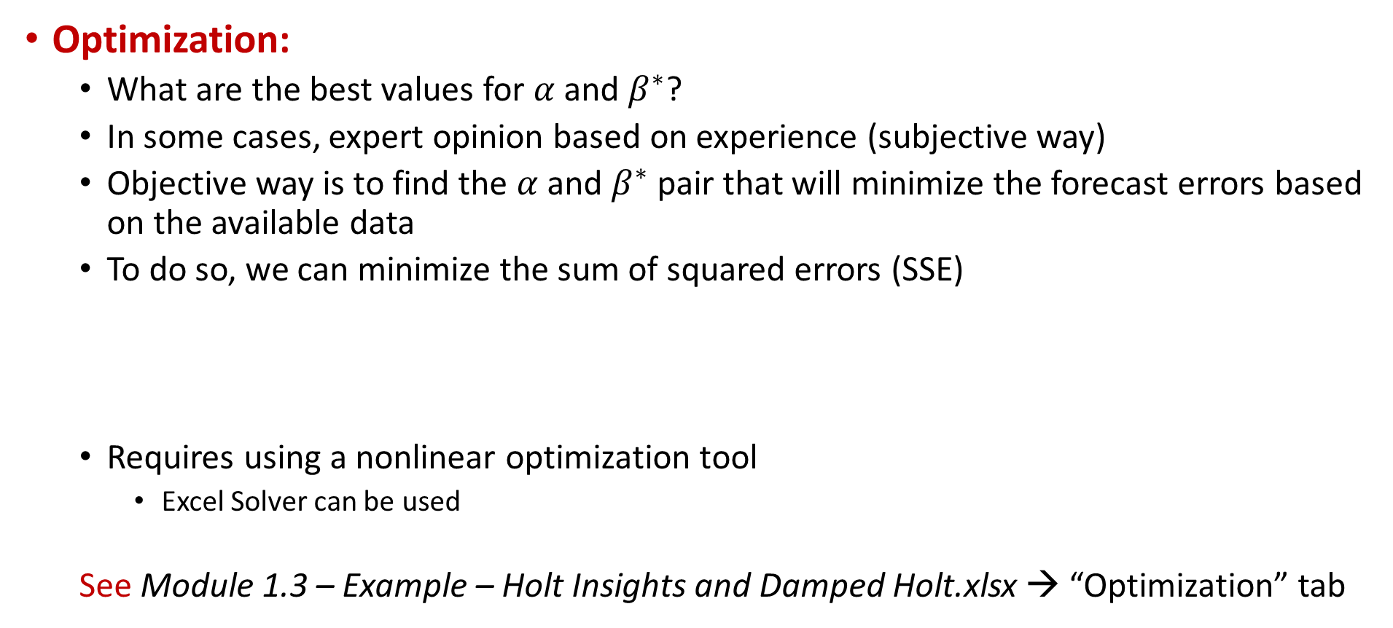
Insights and Optimization
Optimization:
  What are the best values for $α$ and $β^{∗}$?
  In some cases, expert opinion based on experience (subjective way)
  Objective way is to find the $α$ and $β^{∗}$ pair that will minimize the forecast errors based on the available data
  To do so, we can minimize the sum of squared errors (SSE)
  Requires using a nonlinear optimization tool
    Excel Solver can be used
  See Module 1.3 – Example – Holt Insights and Damped Holt.xlsx → “Optimization” tab

Slide 41
Outline
Exponential Smoothing Methods
  Introduction and Notation
Simple Exponential Smoothing
  Forms and Equations, and Example
  Insights and Optimization
Holt’s Linear Trend Method
  Equations and Example
  Insights, Optimization, and Damping
Holt-Winters’ Seasonal Method
  Equations and Example
  Multiplicative and Damped method
Taxonomy of ETS Methods

Slide 42
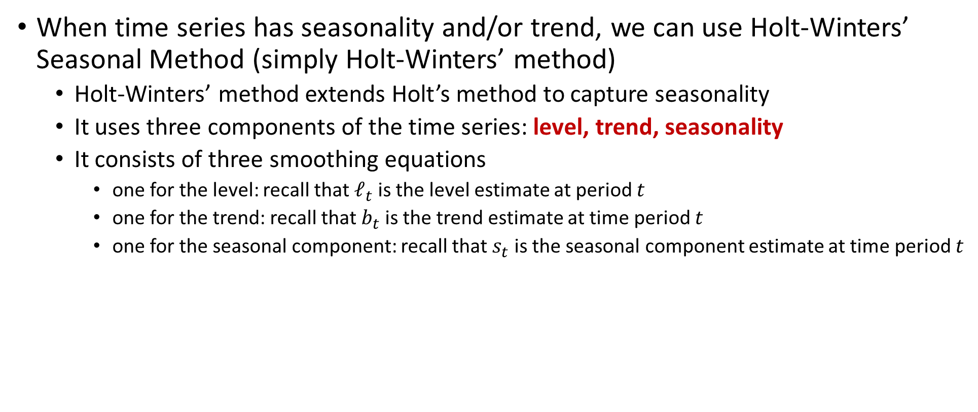
Holt-Winters’ Seasonal Method
When time series has seasonality and/or trend, we can use Holt-Winters’ Seasonal Method (simply Holt-Winters’ method)
  Holt-Winters’ method extends Holt’s method to capture seasonality
  It uses three components of the time series: level, trend, seasonality
  It consists of three smoothing equations
    one for the level: recall that $ℓ_{t}$ is the level estimate at period 𝑡
    one for the trend: recall that $b_{t}$ is the trend estimate at time period 𝑡
    one for the seasonal component: recall that $s_{t}$ is the seasonal component estimate at time period $t$

Slide 43
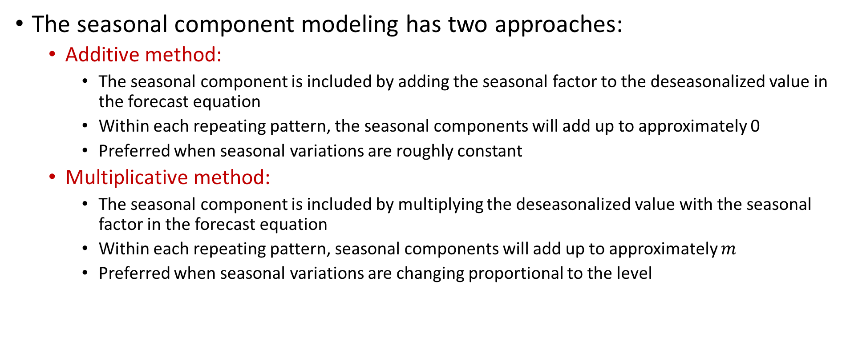
Holt-Winters’ Seasonal Method
The seasonal component modeling has two approaches:
  Additive method:
    The seasonal component is included by adding the seasonal factor to the deseasonalized value in the forecast equation
    Within each repeating pattern, the seasonal components will add up to approximately 0
    Preferred when seasonal variations are roughly constant
  Multiplicative method:
    The seasonal component is included by multiplying the deseasonalized value with the seasonal factor in the forecast equation
    Within each repeating pattern, seasonal components will add up to approximately $m$
    Preferred when seasonal variations are changing proportional to the level

Slide 44




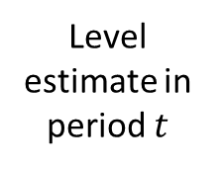

Holt-Winters’ Additive Method
Holt-Winters’ Additive Method: Forecast Equation
  Simply, the h-step-ahead forecast is equal to the last estimated level plus $h$ times the last estimated trend value plus the latest estimate of the seasonal index for period $t+h$
    For instance, if we have weekly seasons (i.e., $m=7$), we are on Friday, and want to forecast demand for next Monday; we will use the estimate of the seasonal index from latest Monday
Forecast made in period $t$ for period $t+h$
Level estimate in period $t$
k is the integer part of (h−1)/m
Seasonal component estimate in period $t$ for
the season period $t+h$
corresponds to
Trend estimate in period $t$

Slide 45








Holt-Winters’ Additive Method
Holt-Winters’ Additive Method: Smoothing Equations
Level equation:
$α$ is the smoothing parameter for level, $0≤α≤1$
Deseasonalized observed value of period $t$
One-step-ahead nonseasonal forecast for period $t$ made in period $t−1$
Trend equation:
$β^{∗}$ is the smoothing parameter for trend, $0≤β^{∗}≤1$
Estimated trend moving from period $(t−1)$ to $t$
Previous trend estimate in period $t−1$
Seasonal
component equation:
$γ$ is the smoothing parameter for seasonal indexes, $0≤γ≤1−α$
Current seasonal index of period $t$
Latest previous seasonal index estimate for the same season

Slide 46



Holt-Winters’ Additive Method
Holt-Winters’ Additive Method: Updating with new data
  In period $t$ after observing $y_{t}$:
  Then use the forecast equation:

Slide 47


Holt-Winters’ Additive Method Example
Holt-Winters’ Additive Method Example: Preliminaries
  Suppose we have the quarterly data for each year and each year shows repeating patterns, so $m=4$
    We will use Holt-Winters’ additive method with
  The data given after initializations and training:
  We are at $t=0$, and we know $ℓ_{0}, b_{0}$, and the latest seasonal index estimates:
    $s_{−3}$ for quarter 1, $s_{−2}$ for quarter 2, $s_{−1}$ for quarter 3, and $s_{0}$ for quarter 4
    To find these initial values, we can use regression and classical decomposition!

Slide 48

Holt-Winters’ Additive Method Example
Holt-Winters’ Additive Method Example: Preliminaries
  Suppose that we want to forecast the value for period $3$, i.e., $h=3$
    Which seasonal index, $s$, to use?
      $k$ is the integer part of $(h−1)/m=(3−1)/4=0.75$, so $k=0$
      $t+h−m(k+1)=0+3−4∗(0+1)=−1$→ so use $s_{−1}$
      Note that $t=3$ corresponds to Q3 of 2005 and $s_{−1}$ is the latest estimate for Q3’s
  How about forecasting for period $6$, i.e., $h=6$
    Which seasonal index, $s$, to use?
      $k$ is the integer part of $(h−1)/m=(6−1)/4=1.25$, so $k=1$
      $t+h−m(k+1)=0+6−4∗(1+1)=−2$→ so use $s_{−2}$
      Note that $t=6$corresponds to Q2 of 2006 and $s_{−2}$ is the latest estimate for Q2’s

Slide 49

Holt-Winters’ Example: Forecasting
Holt-Winters’ Additive Method Example: Forecasting
  Given we’re in period 0 (2004 Q4), what are the forecasts for periods 1 to 5?
  That is, what are ${\hat{y}}_{1|0}$, ${\hat{y}}_{2|0}$, …, ${\hat{y}}_{5|0}$?
    Forecast made in period 0 for period 1
      Period 1 corresponds to Q1 of 2005, so we will use the latest seasonal factor for Q1s, which is $s_{−3}=9.70$
      Noting that h=1, we have ${\hat{y}}_{1|0}=ℓ_{0}+1b_{0}+s_{−3}=32.26+0.70+9.70=42.66$
    Forecast made in period 0 for period 2
      Period 2 corresponds to Q2 of 2005, so we will use the latest seasonal factor for Q2s, which is $s_{−2}=−9.31$
      Noting that h=2, we have ${\hat{y}}_{2|0}=ℓ_{0}+2b_{0}+s_{−2}=32.26+2×0.70−9.31=24.35$

Slide 50

Holt-Winters’ Example: Forecasting
Holt-Winters’ Additive Method Example: Forecasting
    Forecast made in period 0 for period 3
      Period 3 corresponds to Q3 of 2005, so we will use the latest seasonal factor for Q3s, which is $s_{−1}$=-1.69
      Noting that h=3, we have ${\hat{y}}_{3|0}=ℓ_{0}+3b_{0}+s_{−1}=32.26+3×0.70−1.69=32.67$
    Forecast made in period 0 for period 4
      Period 4 corresponds to Q4 of 2005, so we will use the latest seasonal factor for Q4s, which is $s_{0}$=1.31
      Noting that h=4, we have ${\hat{y}}_{4|0}=ℓ_{0}+4b_{0}+s_{0}=32.26+4×0.70+1.31=36.37$
    Forecast made in period 0 for period 5
      Period 5 corresponds to Q1 of 2006, so we will use the latest seasonal factor for Q1s, which is $s_{−3}$=9.70
      Noting that h=5, we have ${\hat{y}}_{5|0}=ℓ_{0}+5b_{0}+s_{−3}=32.26+5×0.70+9.70=45.46$
  See Module 1.3 – Example – Forecasting with Holt-Winters.xlsx

Slide 51

Holt-Winters’ Example: Updated Forecasts
Holt-Winters’ Additive Method Example: Updated Forecasts
  Suppose that we observed the data for Period 1 such that $y_{1}=42.21$
  We will update the level estimate first
    From level equation: $ℓ_{1}=α{(y}_{1}−s_{−3})+\left(1−α\right)\left(ℓ_{0}+b_{0}\right)=32.82$
  We will then update the trend estimate
    From trend equation: $b_{1}=β^{∗}{(ℓ}_{1}−ℓ_{0})+\left(1−β^{∗}\right)b_{0}=0.70$
  Next, we update the seasonal index estimate
    Note that period 1 corresponds to a Q1, so we update Q1 seasonal index
    From seasonal component equation: $s_{1}=γ{(y}_{1}−ℓ_{0}−b_{0})+(1−γ)s_{−3}=9.50$
  For making forecasts in period 1 for future periods, we will use $ℓ_{1}$, $b_{1},$ and seasonal index estimates:
    $s_{1}$ for quarter 1, $s_{−2}$ for quarter 2, $s_{−1}$ for quarter 3, and $s_{0}$ for quarter 4

Slide 52

Holt-Winters’ Example: Updated Forecasts
Holt-Winters’ Additive Method Example: Updated Forecasts
  Given we’re in period 1, what are the forecasts for periods 2 to 6?
  That is, what are ${\hat{y}}_{2|1}$, ${\hat{y}}_{3|1}$, …, ${\hat{y}}_{6|1}$?
    Forecast made in period 1 for period 2
      Period 2 corresponds to Q2 of 2005, so we will use the latest seasonal factor for Q2s, which is $s_{−2}$=-9.31
      Noting that h=1, we have ${\hat{y}}_{2|1}=ℓ_{1}+1b_{1}+s_{−2}=32.82+1×0.70−9.31=24.21$
    Forecast made in period 1 for period 3
      Period 3 corresponds to Q3 of 2005, so we will use the latest seasonal factor for Q3s, which is $s_{−1}$=-1.69
      Noting that h=2, we have ${\hat{y}}_{3|1}=ℓ_{1}+2b_{1}+s_{−1}=32.82+2×0.70−1.69=35.91$

Slide 53

Holt-Winters’ Example: Updated Forecasts
Holt-Winters’ Additive Method Example: Updated Forecasts
    Forecast made in period 1 for period 4
      Period 4 corresponds to Q4 of 2005, so we will use the latest seasonal factor for Q4s, which is $s_{0}$=1.31
      Noting that h=3, we have ${\hat{y}}_{4|1}=ℓ_{1}+3b_{1}+s_{0}=32.82+3×0.70+1.31=36.23$
    Forecast made in period 1 for period 5
      Period 5 corresponds to Q1 of 2006, so we will use the latest seasonal factor for Q1s, which is $s_{1}$=9.50
      Noting that h=4, we have ${\hat{y}}_{5|1}=ℓ_{1}+4b_{1}+s_{1}=32.82+4×0.70+9.50=45.12$
    Forecast made in period 1 for period 6
      Period 6 corresponds to Q2 of 2006, so we will use the latest seasonal factor for Q1s, which is $s_{−2}$=-9.31
      Noting that h=5, we have ${\hat{y}}_{6|1}=ℓ_{1}+5b_{1}+s_{−2}=32.82+5×0.70−9.31=27.01$
  See Module 1.3 – Example – Forecasting with Holt-Winters.xlsx

Slide 54


Holt-Winters’ Multiplicative Method
Holt-Winters’ Multiplicative Method: Forecast Equation
  Instead of adding the seasonal component to the deseasonalized forecast, the deseasonalized forecast is multiplied with the seasonal component
Smoothing equations:
  Deseasonalization is via dividing by seasonal component
  See Module 1.3 – Example – Forecasting with Holt-Winters.xlsx

Slide 55

Holt-Winters’ Damped Method
Holt-Winters’ Damped Method:
  Damping is possible for both additive and multiplicative approaches
Damping for multiplicative Holt-Winters’ method:
  Forecast Equation:
  Smoothing Equations:

Slide 56
Outline
Exponential Smoothing Methods
  Introduction and Notation
Simple Exponential Smoothing
  Forms and Equations, and Example
  Insights and Optimization
Holt’s Linear Trend Method
  Equations and Example
  Insights, Optimization, and Damping
Holt-Winters’ Seasonal Method
  Equations and Example
  Multiplicative and Damped method
Taxonomy of ETS Methods

Slide 57
Taxonomy of ETS Methods
All ETS methods consider level component
Some ETS methods consider trend or trend and seasonality
Trend component can be damped
Seasonality component can be included using an additive or multiplicative approach
  Multiplicative trend modeling is possible, however, typically produces poor forecasts
As a result, we have 9 combinations of ETS method

Slide 58


Taxonomy of ETS Methods
9 combinations of ETS method:
  $(A,M)$is the method with an additive trend and multiplicative seasonality
  $(A_{d},N)$is the method with additive damped trend and no seasonality
  And so on…

Slide 59

Taxonomy of ETS Methods
Some of these methods have their individual names:

Slide 60


Taxonomy of ETS Methods
For reference:

